Slide 1
ChatBot Sprint 1 Demo
Members: Eli Kulpinski, Christopher Mata, and Aaron Antreassian

Slide 2
ChatBot Project Plan:
Project Goal: Adding a large language model chatbot/agent to the UWP Website for basic question answering and navigation.
Target Audience: New and existing users of the Parkside website.
Benefits:
Streamlining Navigation: The chatbot/agent will assist users in finding specific links on the website, simplifying their experience.
Instant Answers: Users can ask the chatbot questions, and it will provide direct answers, improving user interaction with the information-rich website.
24/7 Availability: The chatbot/agent can provide assistance around the clock, ensuring that users can get help or information at any time, even outside of regular office hours.
User Engagement: A conversational chatbot can increase user engagement with the website, making it more interactive and user-focused.
Overall Impact: This implementation aims to make navigating the Parkside website more accessible and user-friendly, enhancing the experience for both new and existing users.

Slide 3
Sprint Contributions
Aaron:
Project Goals and Scope Meeting
Research Content and Tools
Setup Local Environment + MVP
OpenAI and Local Models Meeting
Setup Demo Presentation
Pre-Demo Meeting
Chris:
Project Goals and Scope Meeting
Research Content and Tools
Setup Local Environment + MVP
Setup Jira Sprints
OpenAI and Local Models Meeting
Pre-Demo Meeting
Additional Work Getting the MVP to Run on the Mac M2 Processor
Eli:
Setup Meeting Times
Distribute Research Resources
Host OpenAI and Local Models Prep Meeting
Clone CS Website for Testing
Pre-Demo Meeting
QA Check Demo Related Work

Slide 4
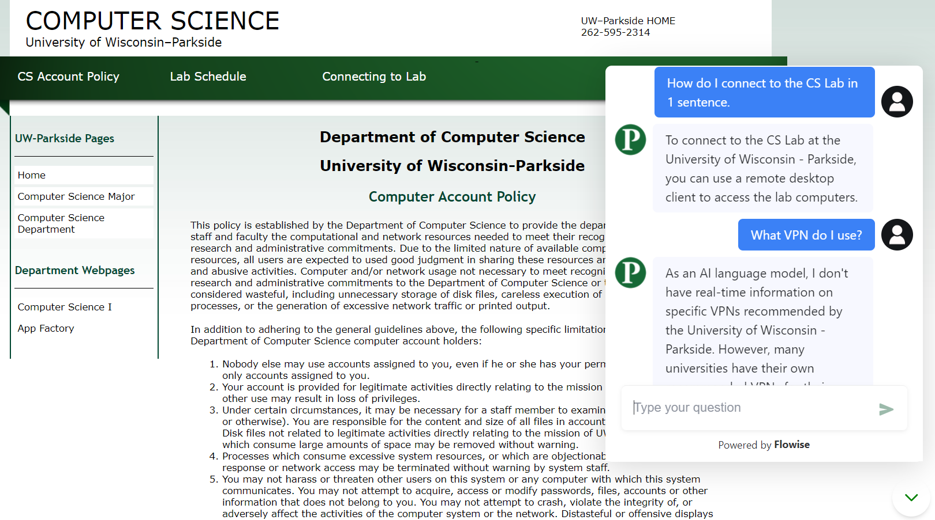
Website Demo: Live or Static

Slide 5
Sprint 2 Objectives: Transitioning to a Local Model
Transition from LangFlow to LangChain
Finalize criteria for evaluating large language models
Choose five local LLMs per member to evaluate
Discuss our models results
Evaluate each member's top model (top three)
Compare and Implement the best model for our use case
Add a vectorized database for information storing functionality

